Slide 1
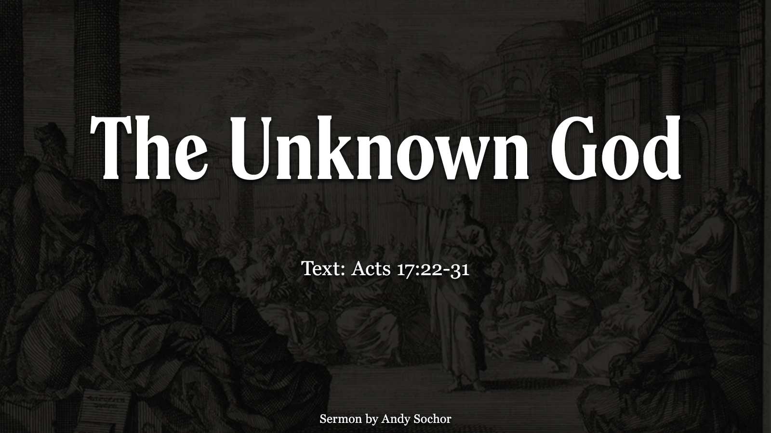

Slide 2
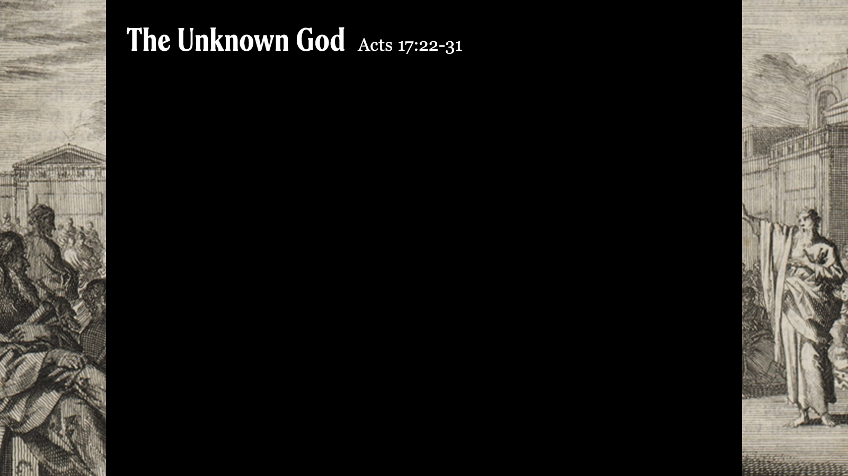
Teaching about the “Unknown God”
He gives life and breath and all things (v. 25) – all people are made in His image (Gen. 1:27); He blesses us with every good thing (James 1:17)
He blesses us whether we serve Him or not (v. 24-25) – many do not serve God, but He blesses them; this shows His great love for man
He blesses us whether we know of Him or not (v. 23) – this serves as a “witness” to His existence and goodness (Acts 14:16-17)
He made it so that we could find Him (v. 27) – His attributes are clearly seen in His creation (Rom. 1:20); He rewards those who seek Him (Heb. 11:6)

Slide 3
Why Should People Seek After God?
Why seek after God if He blesses those who do not know or serve Him? – there is a day of judgment coming (v. 30-31)
This world and its blessings are temporary (2 Pet. 3:10) – there is something beyond this life
So what should we do? – repent; prepare to stand before the Lord in judgment (2 Cor. 5:10; Jn. 12:48)

